Slide 1



AI Project

Slide 2
Contents
1-HISTORY OF TOWER OF HANOI
2-Rules of Tower of Hanoi Puzzle
3-The Solution steps

Slide 3
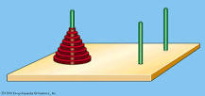
HISTORY OF TOWER OF HANOI
The Tower of Hanoi is widely believed to have been invented in 1883 by the French mathematician Edouard Lucas
though his role in its invention has been disputed. Ever popular, made of wood or plasti

Slide 4
HISTORY OF TOWER
Tower of Hanoi consists of three pegs or towers with n disks placed one over the other.
The objective of the puzzle or Problem is to move the stack to another peg following these simple rules :
Only one disk can be moved at a time.
No disk can be placed on top of the smaller disk.

Slide 5
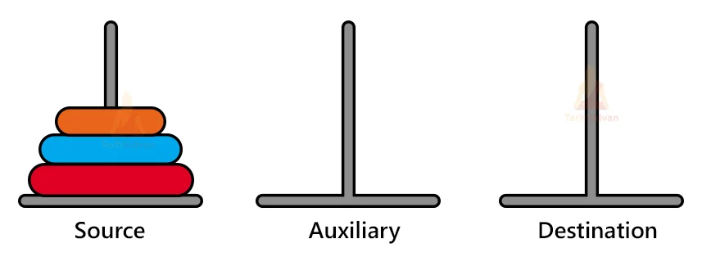
Rules of Tower of Hanoi Puzzle
Only one disc can be moved at a time.
Only the top disc of one stack can be transferred to the top of another stack or an empty rod.
Larger discs cannot be stacked over smaller ones

Slide 6
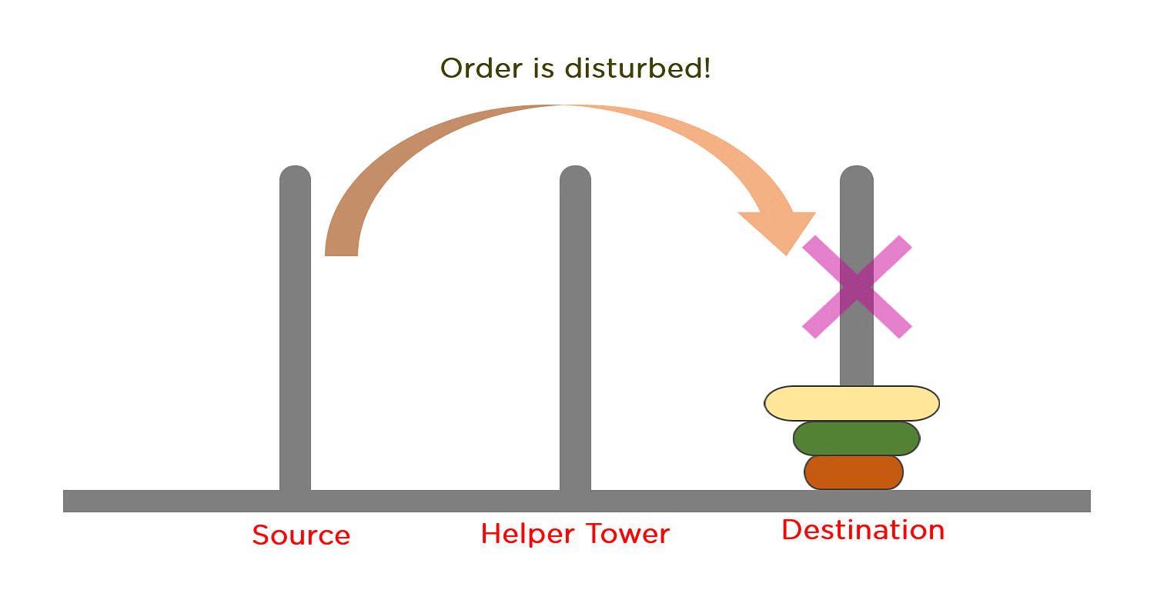
Rules ( Hanoi Puzzle )

Slide 7
Rules ( Hanoi Puzzle )

Slide 8
The Solution steps
Step 1 − Move disk from tower A to tower C
Step 2 − Move disk disk from tower A to tower B
Step 3 − Move disk disks from tower C to tower B
Step 4 − Move disk from tower A to tower C
Step 5 − Move disk disks from tower B to tower A
Step 6 − Move disk disks from tower B to tower C
Step 7 − Move disk from tower A to tower C

Slide 9
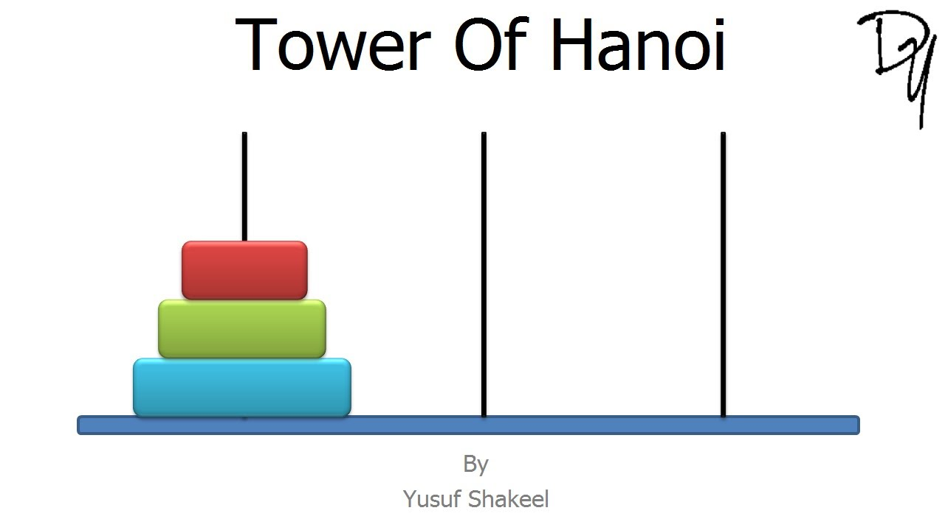




Short activity :

Slide 10
Thanks any questions
"C:\Users\Naif\Pictures\Screenshots\‏‏لقطة الشاشة (358).png"

Slide 11
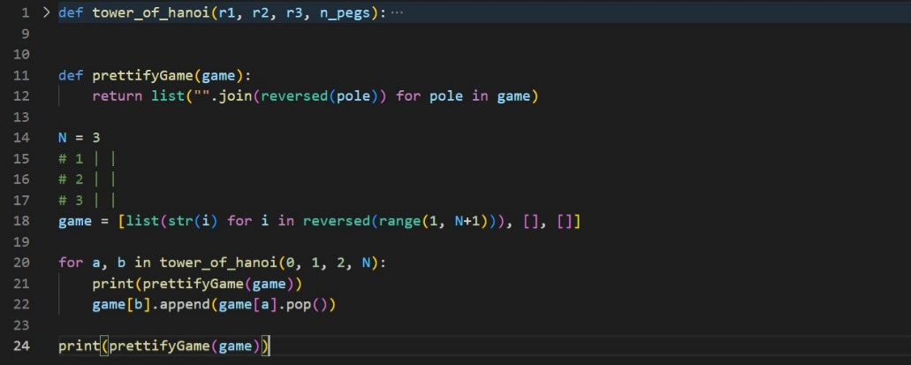
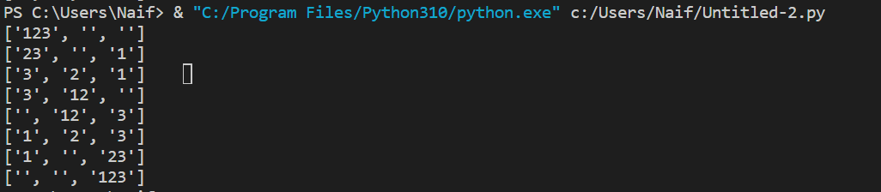
Code

